Slide 1


NATIONAL INSTITUTE OF TECHNOLOGY, WARANGAL
Machine Learning-Assisted Exploration of Thermally Conductive Polymers
MLMI PRESENTATION
Presenter:
Harsh Hotala (22EEB0A64)
Vivek Kumar (21BTB0A81)

Slide 2
Machine Learning-Assisted Exploration of Thermally Conductive Polymers
Using High-Throughput Molecular Dynamics to Find New Materials

Slide 3
CONTENTS OF THE PRESENTATION
This slide lists the main sections of the talk:
Introduction
The Problem
Simulation setup
Equations (RDF, MSD, ARRHENIUS)
Workflow Diagram
ML models & equations
Results
References

Slide 4

We Need Better Plastics for Heat Transfer
Most amorphous polymers (like everyday plastics) are thermal insulators (they trap heat).
But, we need them to conduct heat for applications like electronics, thermal interface materials, and heat exchangers.
The Problem: Finding these special high-conductivity polymers is like finding a needle in a haystack.
Why?
Experimentally testing thousands of polymers is too slow and expensive. Existing databases are very small and have "noisy" data.

Slide 5
Why is Finding High-TC Polymers Hard?
Problem 1: Too Slow. Experimentally synthesizing and testing thousands of potential polymers is not feasible.
Problem 2: Too Expensive. The cost of materials and lab time is extremely high.
Problem 3: Bad Data. Existing databases for polymer thermal conductivity are very small and often contain "noisy" or unreliable data.
We need a faster, cheaper, and more accurate method.

Slide 6
A Clear Target: Find Polymers > 0.300 W/m-K
Our goal is to create a new, high-speed method to screen thousands of potential polymer structures.
Our Target: Find new amorphous polymers with a Thermal Conductivity (TC) greater than 0.300 W/m-K.
This is a key threshold, as most common polymers are well below this value.

Slide 7
Our Workflow: Simulate, Learn, Discover
We can't do experiments, so we'll use a computer-based workflow.
Part 1: Molecular Dynamics (MD) [Data Generation]
First, we need reliable data to learn from.
We used computer simulations (MD) to precisely calculate the TC for 365 random polymers. This creates our "training dataset."
Part 2: Machine Learning (ML) [Screening]
Next, we trained an AI (a Random Forests model) on this new data.
The AI "learned" the link between a polymer's chemical structure and its TC
(R^2 = 0.789).
We then used this trained AI to screen a massive database of 12,777 polymers instantly.

Slide 8
How We Simulate: Molecular Dynamics (MD)
MD (Molecular Dynamics) is a computer simulation method that models the physical movement of atoms.We used MD to build 365 random polymer structures and precisely calculate their Thermal Conductivity (TC). This creates the reliable "ground truth" data needed to train our ML model.Core Calculation: Fourier's Law
The thermal conductivity (k) is calculated from the simulation using Fourier's Law:
k=-J/ T
Where:
K is the Thermal Conductivity.
J is the heat flux (energy flow) we apply in the simulation.
( T) is the resulting temperature gradient across the polymer.

Slide 9
How We Screen: Machine Learning (ML)
Model: We used a Random Forests (RF) model. This model builds hundreds of simple "decision trees" and averages their predictions to make a final, highly accurate one.
Training: The RF model was trained on our 365 simulated polymers.
Result: It "learned" the complex relationship between a polymer's chemical structure and its thermal conductivity, achieving a high correlation (R^2 = 0.789).
The final prediction is the average (or majority vote) of all individual decision trees (h_i):
k
Final TC= 1/k h_i(structure features)
i=1
Where:
k is the number of trees in the forest.
h_i is a single decision tree.
structure features are the chemical descriptors of the polymer.

Slide 10
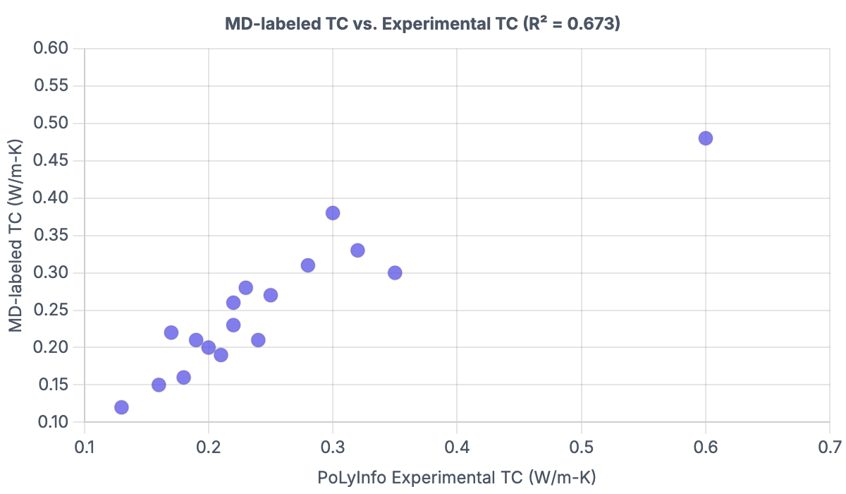

Slide 11
Our Simulations are Reliable
NEMD (Heat/Sink)
Monomer
Polymer
Anneal
Get TC (κ)
The core calculation is Fourier's Law: κ = -J / ∇T,
where 'J' is heat flux and '∇T' is the temperature gradient.

Slide 12

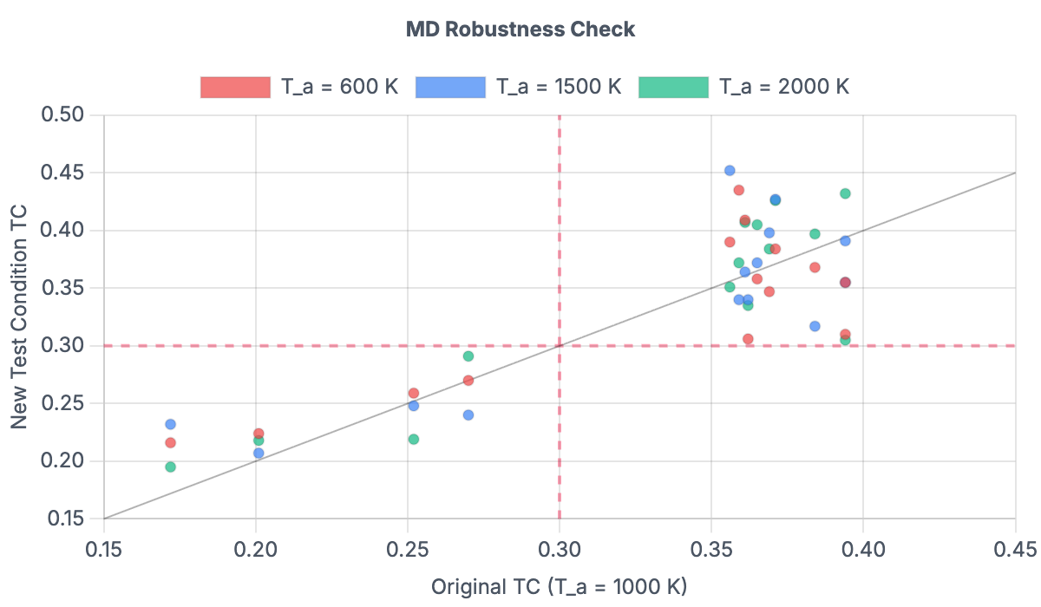
While noisy, polymers with TC > 0.300 W/m-K (top-right quadrant) almost always stayed above that threshold. This confirms the MD data is reliable for our screening goal.

Slide 13
ML Screening is 8x More Efficient
Method 1: Random Search (Our 1st Dataset)
We randomly simulated 365 polymers.
Only 41 polymers were high-TC (> 0.300 W/m-K).
Hit Rate: 11% (Inefficient)
Method 2: ML-Guided Search (Our 2nd Dataset)
Step 1: Our trained AI screened a massive database of 12,777 polymers.
Step 2: The AI predicted 89 "top candidates" most likely to be high-TC.
Step 3: We only had to simulate those 89 candidates.
Step 4: 80 out of 89 were confirmed to be high-TC.
Hit Rate: 89.9% (Highly Efficient!)

Slide 14
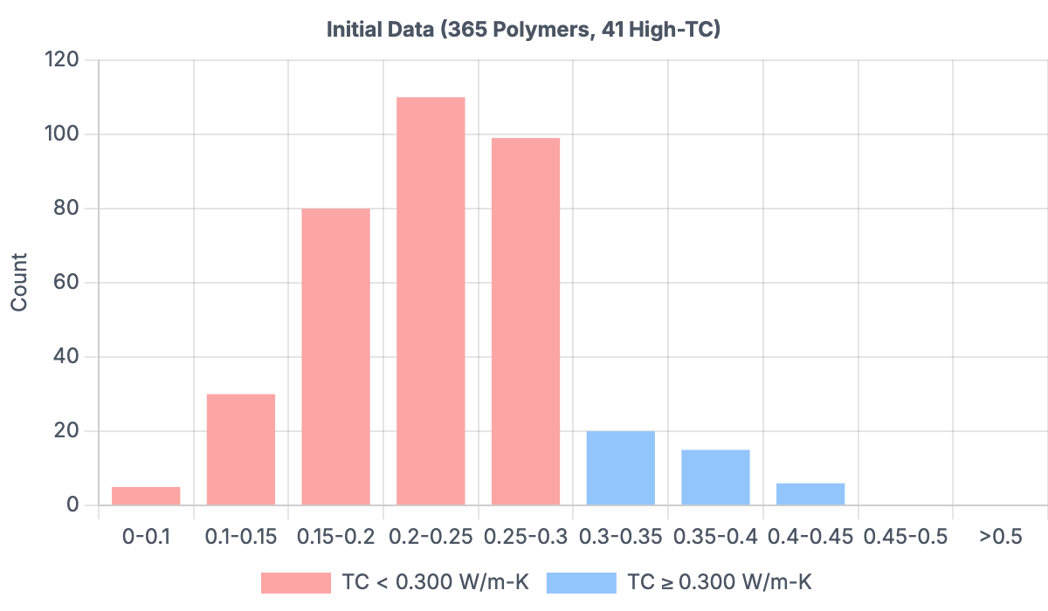
Saturday, November 1, 2025

Slide 15
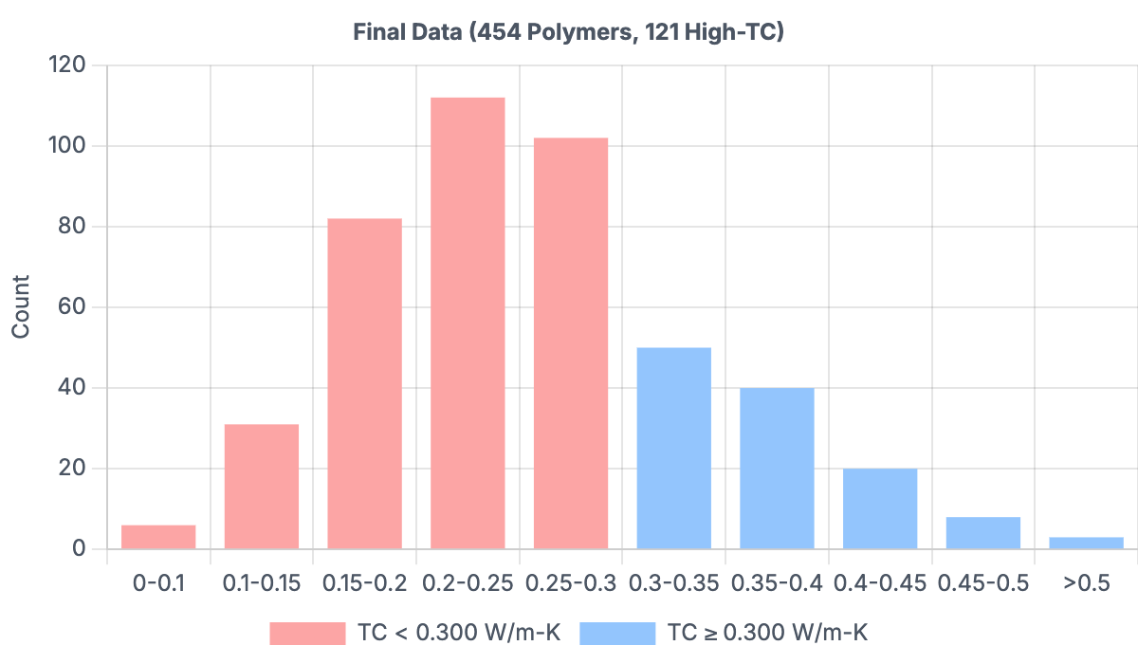
Saturday, November 1, 2025

Slide 16
Results: Visualizing Our Success
These histograms show the distribution of TC in our data. The blue bars represent the high-TC polymers we wanted to find.
Initial Data (Left): In our first random dataset, the high-TC polymers (blue) are rare.
Final Data (Right): After the ML-guided search, our dataset is now enriched with high-TC polymers. We went from 41 total to 121 total.

Slide 17
What We Found: 121 New High-TC Polymers
Our ML-guided search was a huge success, identifying 121 new amorphous polymers with TC > 0.300 W/m-K.
This includes 34 polymers with exceptionally high thermal conductivity (TC > 0.400 W/m-K).
What Do These New Polymers Have in Common?
The ML model helped identify the most promising chemical classes for high thermal conductivity. The two strongest candidates for future research are:
Polyamides
Polysulfides

Slide 18
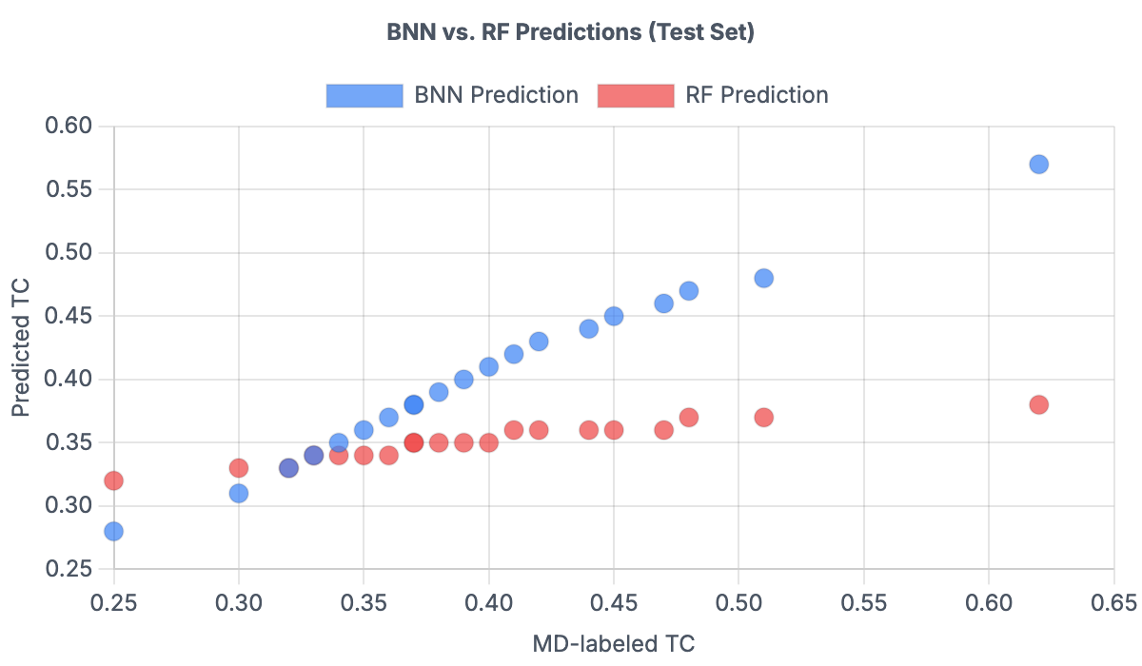
We Also Built a Better, "Smarter" AI

Slide 19
Conclusion
We proved that combining Molecular Dynamics (MD) and Machine Learning (ML) is a powerful and effective strategy for discovering new materials.
We successfully increased our discovery "hit rate" from 11% (random search) to 89.9% (ML-guided search).
We created a new, valuable database of 121 high-TC polymers for future experimental research.
We identified Polyamides and Polysulfides as the most promising chemical structures to investigate next.

Slide 20
8. REFERENCES
[1] A. Henry, Thermal transport in polymers, Annual Review of Heat Transfer 17
(2014).
[2] N. Mehra, et al., Thermal transport in polymeric materials and across composite
interfaces, Appl. Mater. Today 12 (2018) 92–130.
[3] X. Xu, J. Chen, J. Zhou, B. Li, Thermal conductivity of polymers and their
nanocomposites, Adv. Mater. 30 (17) (2018).
[4] X. Wei, Z. Wang, Z. Tian, T. Luo, Thermal transport in polymers: a review, J. Heat
Tran. 143 (7) (2021).
[5] Z. Han, Fina Alberto, Thermal conductivity of carbon nanotubes and their polymer
nanocomposites: a review, Prog. Polym. Sci. 36 (7) (2011) 914–944.
[6] O. Breuer, Uttandaraman Sundararaj, Big returns from small fibers: a review of
polymer/carbon nanotube composites, Polym. Compos. 25 (6) (2004) 630–645.

Slide 21
THANK YOU
Questions?

